Slide 1
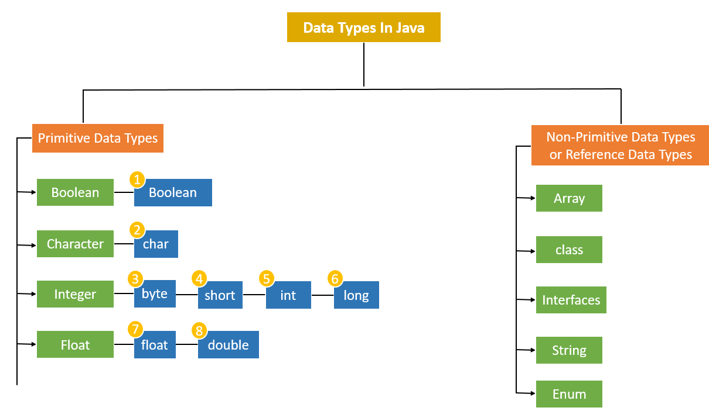
Data types:
1 bit
2 bytes
1 byte
2 bytes
4 bytes
8 bytes
4 bytes
8 bytes

Slide 2
Module-3:
INTERFACES AND PACKAGES

Slide 3
What is an interface?
In Java, an interface is a reference type, similar to a class, that can contain only
public and abstract methods (Starting with Java 8, you can also have default and static methods in an interface)
public static final fields.
It cannot have Constructor
Interfaces specify what a class must do, but not how it does it.
A class that implements an interface must implement all of its methods unless it is an abstract class.
Interfaces are used to achieve:
Abstraction,
Multiple Inheritance, and
Loose coupling between components in Java.

Slide 4
Data Abstraction
Abstract Classes and Interfaces

Slide 5
What is Abstract Method:
An abstract method is a method declared without a body. It must be overridden in the subclass. The method signature includes the abstract keyword, and there is no method body.
Key Rules for Abstract Methods:
Must be declared in an abstract class.
Cannot have a method body.
Subclasses that extend the abstract class must override the abstract method.

Slide 6
final Fields (Constants): When we use a final Keywork with a variable it becomes Constant or final Variable.
When Used with Variable
Ex: int age = 20
It Becomes Constant
Ex: final int age = 20

Slide 7
What is Abstract Class:
An Abstract Class in object-oriented programming is a class that cannot be instantiated directly. It serves as a blueprint for other classes. Abstract classes are used when you want to define some common behavior (methods) that other classes should inherit and implement, but the abstract class itself should not be instantiated. In other words, an abstract class can have abstract methods (without implementation) and/or concrete methods (with implementation).

Slide 8
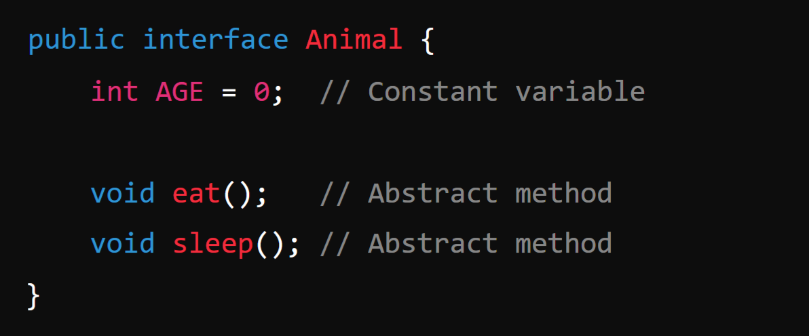
Defining and Creating an interface:
Declaration: An interface is declared using the interface keyword:
Note:
By default all the Methods inside an interface is Abstract methods and also all the fields in inside an interface are final or constant.

Slide 9
2. Implementation by a Class:
A class can implement an interface by using the implements keyword. The class must provide implementations for all of the interface's abstract methods.
Example:
In this example, Dog implements the Animal interface and provides concrete implementations of the eat() and sleep() methods.

Slide 10
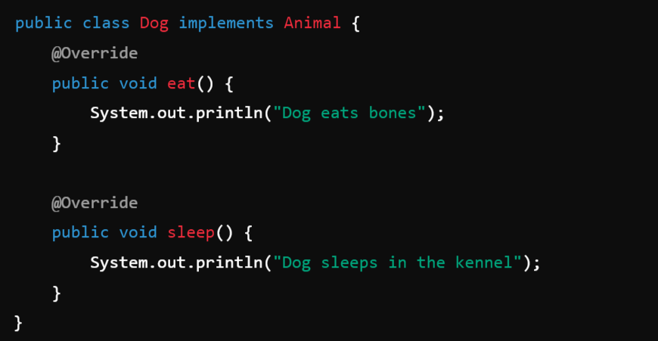

Slide 11
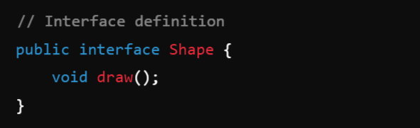
Accessing implementations through interface references:
This means that you interact with an object of a class that implements an interface via a reference of that interface type, not the class type. This allows you to use the object polymorphically, meaning that the actual implementation is determined at runtime, but you interact with it using the common interface methods.
Example:
1. Below Code is for Creating an interface with name Shape

Slide 12
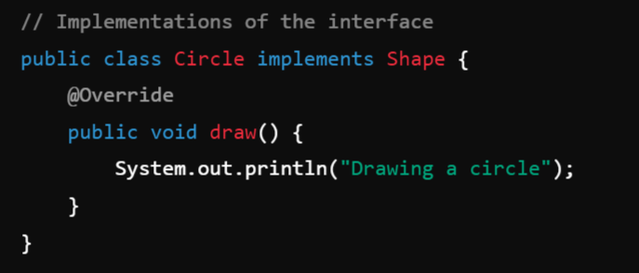
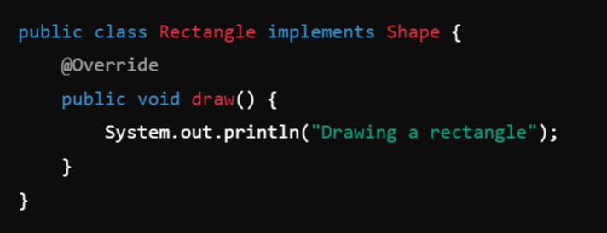
2. Class Circle implements the Interface Shape:
3. Class Rectangle implements the Interface Shape:

Slide 13
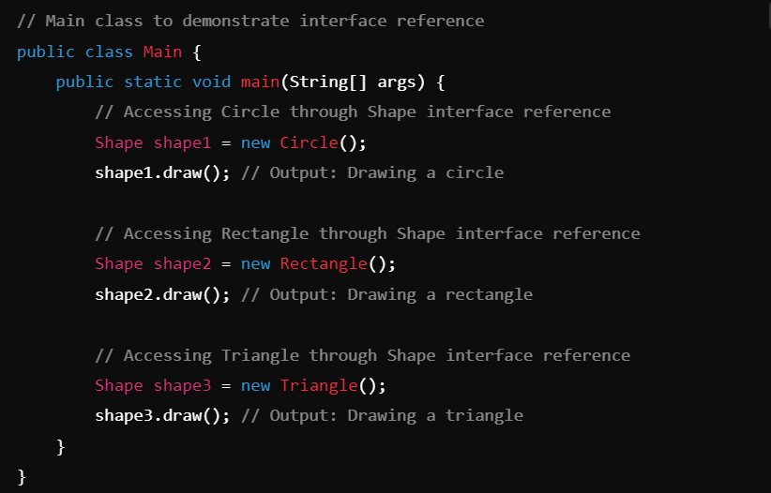
Main Class:

Slide 14
Extending interface:
In Java, interfaces can extend other interfaces, similar to how classes can extend other classes.
When one interface extends another, it inherits all the abstract methods, default methods, and constants (static and final fields) from the parent interface. This allows you to create a more specialized interface by building upon an existing one.
Unlike classes, where a subclass can only extend one parent class (due to single inheritance), an interface in Java can extend multiple interfaces, allowing for a form of multiple inheritance.

Slide 15
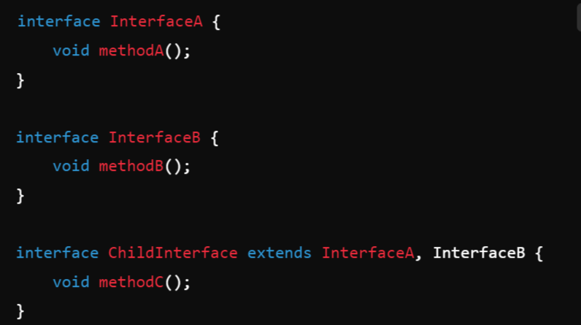
Syntax:

Slide 16
Interfaces VS Abstract classes:
In Java, both interfaces and abstract classes are used to define abstract types, which cannot be instantiated directly.
Data Abstraction -> Abstract class & Interfaces.

Slide 17
Feature | Interface | Abstract Class
Created Using | interface Keyword | abstract keyword
Multiple Inheritance | Yes | No
Default Methods | Yes (Java 8+) | No (but can have concrete methods)
Static Methods | Yes (Java 8+) | Yes
Fields | Public, static, and final only | Any type of field
Constructors | No | Yes (cannot instantiate directly)
Method Modifiers | Public (Java 9+ allows private methods) | Can be public, private, protected
Abstract/Concrete Methods | Abstract, default, or static | Both abstract and concrete methods
Use Case | To define capabilities (behavior) | To define a base class (object template)
Inheritance | A class can implement multiple interfaces | A class can extend only one class

Slide 19
Module-3: INTERFACES AND PACKAGES (5 hrs)
Interface: Interfaces VS Abstract classes, defining an interface, implement interfaces, accessing implementations through interface references, extending interface.
Packages: Defining, creating and accessing a package, understanding CLASSPATH, importing packages

